Slide 1
Enterprise DevOps Migration
From legacy Jenkins pipelines and traditional application deployment to Azure DevOps, containerized delivery, and Azure App Service
Repository: GitHub Repository
Presenter: Akshhaya Lakshmi Sankaranarayanan

Slide 2
Agenda
Application Modernization
Application baseline and deployment assumptions
Containerization using a multi-stage Docker build
Local ingress and egress simulation
Azure infrastructure provisioning with Terraform
Deployment to Azure App Service for Containers
Pipeline Modernization
Legacy pipeline discovery and migration assessment
Self-hosted Azure DevOps agent setup
Azure DevOps YAML conversion with reusable templates
Secure build, deploy, and validation workflow
Governance, monitoring, and production readiness

Slide 3
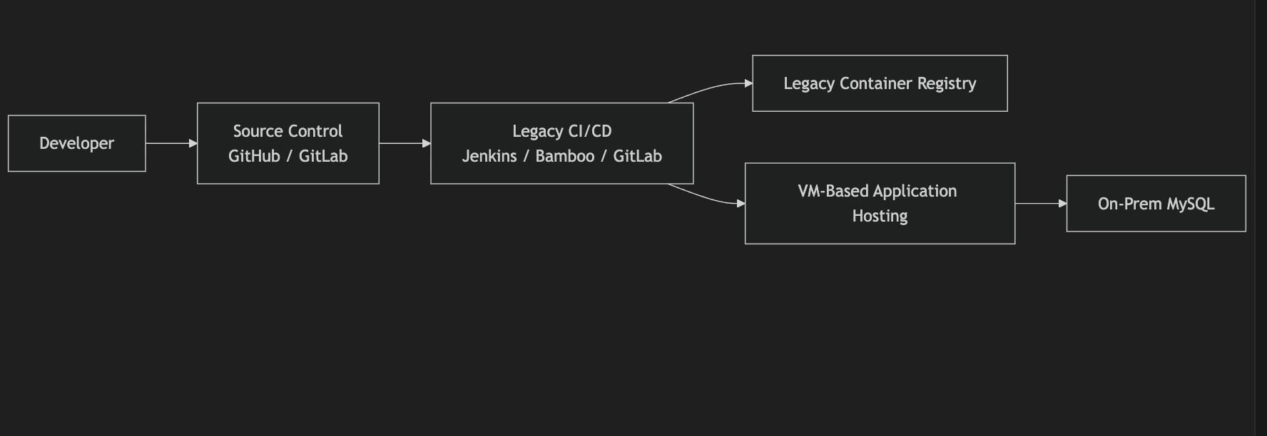
Application Baseline and Deployment Assumption

Slide 4
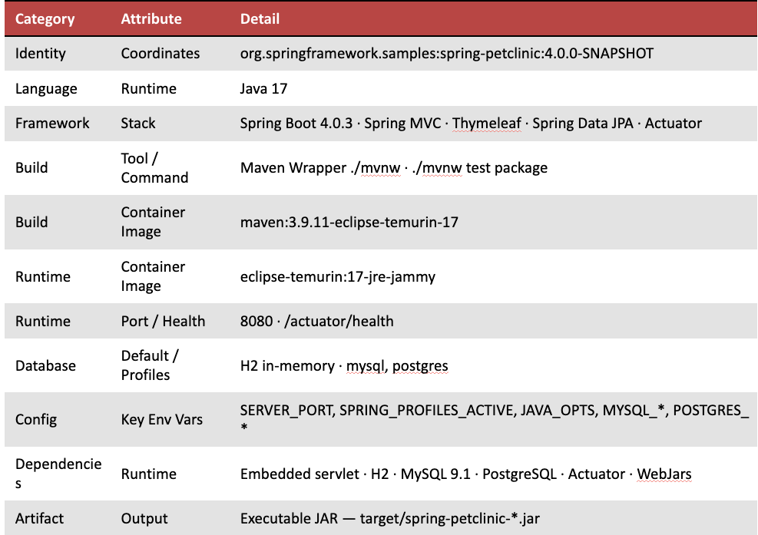
Application Inventory
Github URL: Application Inventory

Slide 5
Legacy Pipeline Discovery
Three Pipelines discovered (Jenkins, Bamboo and GitLab)
URL: Pipeline Inventory Analyzer
Scans legacy CI directory → classifies runner model, secrets handling, artifact store, and deployment method → outputs risk-scored reports
Pipeline | Runner | Secrets | Deployment | Risk
Jenkins | agent any | withCredentials + plain-text password | VM SSH | 🔴 Critical
Bamboo | Local agent | Plan variables | VM SSH | 🟠 High
GitLab CI | Docker runner | Pipeline variables | VM SSH | 🟠 High

Slide 6
Migration Mapping
Migration Mapping translates every legacy CI/CD concept — pipeline definitions, secrets handling, artifact tagging, and deployment methods — into their direct Azure DevOps equivalents. It ensures no capability is lost during migration while closing security and governance gaps identified in the risk assessment.
URL: Migration_mapping
Legacy (Jenkins / Bamboo / GitLab) | Azure DevOps Equivalent | Priority
Jenkinsfile / bamboo-specs.yml / .gitlab-ci.yml | azure-pipelines.yml | Structural migration
Jenkins Shared Library @Library | Reusable templates in templates | Refactor — no Groovy DSL
withCredentials plain-text secrets | Key Vault-backed variable group petclinic-shared | 🔴 Highest — eliminate plain-text
:$BUILD_NUMBER / :${bamboo.buildNumber} | :$(Build.BuildId) + :git-$(shortSha) | Immutable promotion chain
echo $PASS https://github.com/Akshhaya97/jenkins-ado-assessment/blob/main/reports/migration_mapping_matrix.csv docker login | Docker@2 with ACR service connection | No runtime credential injection

Slide 7
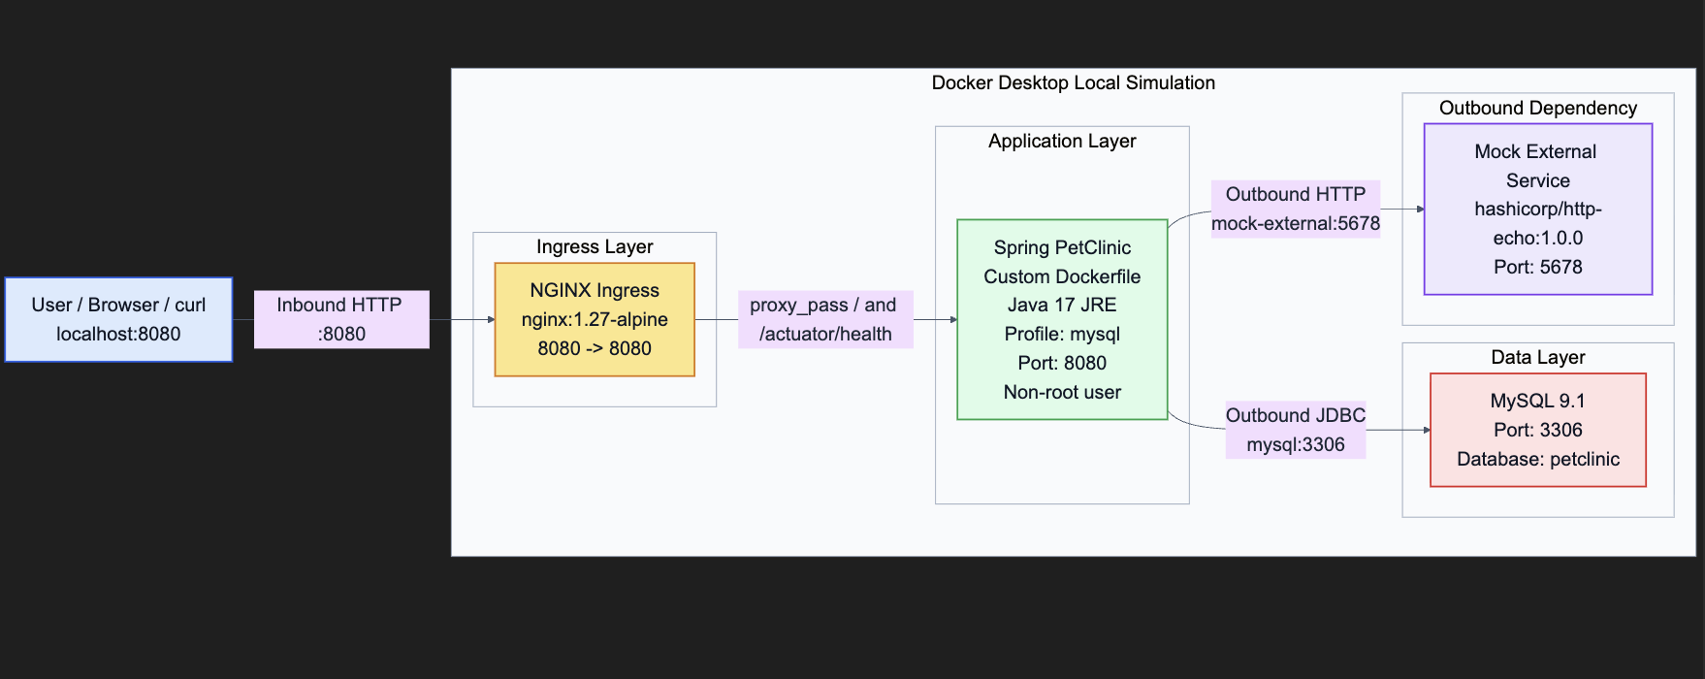
Local Simulation - Docker

Slide 8
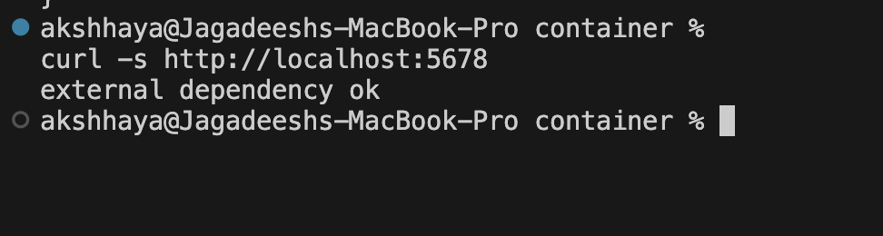
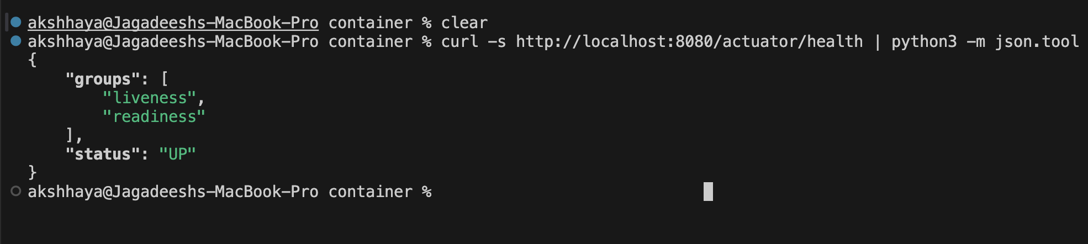
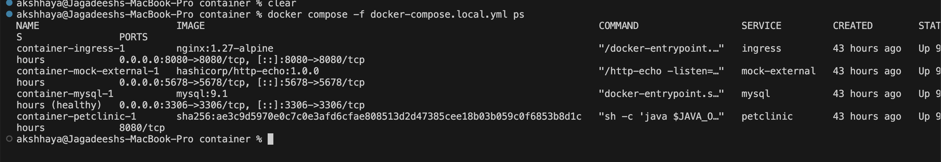
Local Simulation-containerization & evidences
Non-root execution — runs as springuser UID 10001, no root escape from container
Minimal base image — eclipse-temurin:17-jre (JRE only, not JDK), reduces attack surface
No secrets in image — all credentials injected at runtime via env vars, nothing baked into layers
Layer caching — dependencies cached before source copy for faster CI builds
No extra packages — apt-get not called in runtime stage, fewer CVEs and smaller image
Same binary end-to-end — docker save → artifact → docker load prevents silent rebuilds between scan and push

Slide 9
Azure IaC - Terraform
Infrastructure defined entirely in Terraform across 12 purpose-built modules
Covers networking, security, compute, database, registry, and observability layers
VNet with 5 dedicated subnets — App Gateway, App Service, Agent, Private Endpoints, Firewall
Azure Firewall + UDR enforces all outbound egress across every subnet
App Service for Containers deployed with VNet integration and app settings injected via variables
MySQL Flexible Server and ACR exposed only via Private Endpoints — no public access
Application Gateway with WAF v2 as the entry point — backend routed to App Service FQDN
User-Assigned Managed Identity as the OIDC base for pipeline authentication — no stored credentials

Slide 10
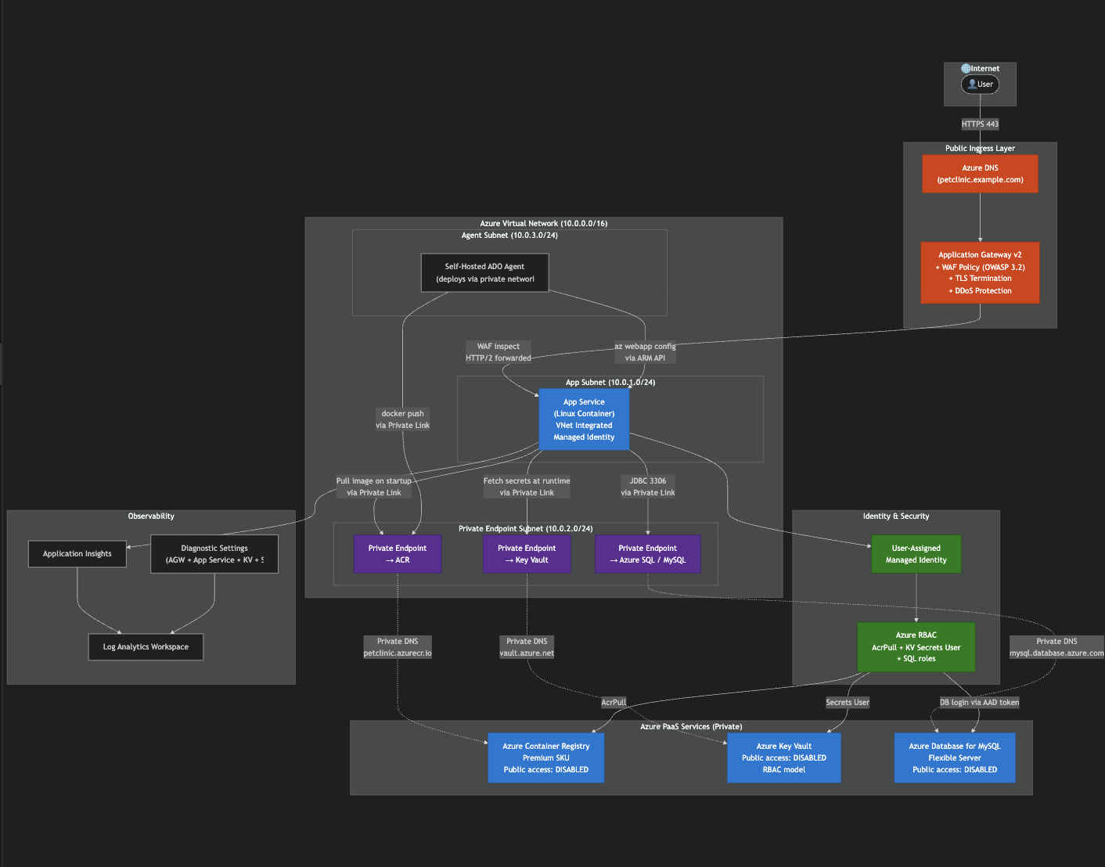
Target Architecture

Slide 11
Agent Network & Operational Requirements
Requirement | Details
Network placement | Agent must be in the same VNet (or peered) to reach private endpoints
Outbound internet | Allow dev.azure.com, *.blob.core.windows.net, *.azurecr.io, aka.ms
Private endpoint access | UDR routes all agent traffic through the Firewall — no direct public access
Secrets handling | Rotate PAT every 90 days; never bake the token into the image

Slide 12
Agent Model — When to Use Which
Model | Best For | Limitations
Self-hosted (this project) | Private VNet · enterprise toolchain · license tools · controlled egress | You own patching, scaling, and availability
VM Scale Sets | Elastic workload · cost-optimised · auto-scale to zero | ADO manages scaling; you still own the base VM image
Managed DevOps Pools | Microsoft-managed self-hosted — best of both worlds | VNet Integration needs extra configuration- regional availability varies by subscription

Slide 13
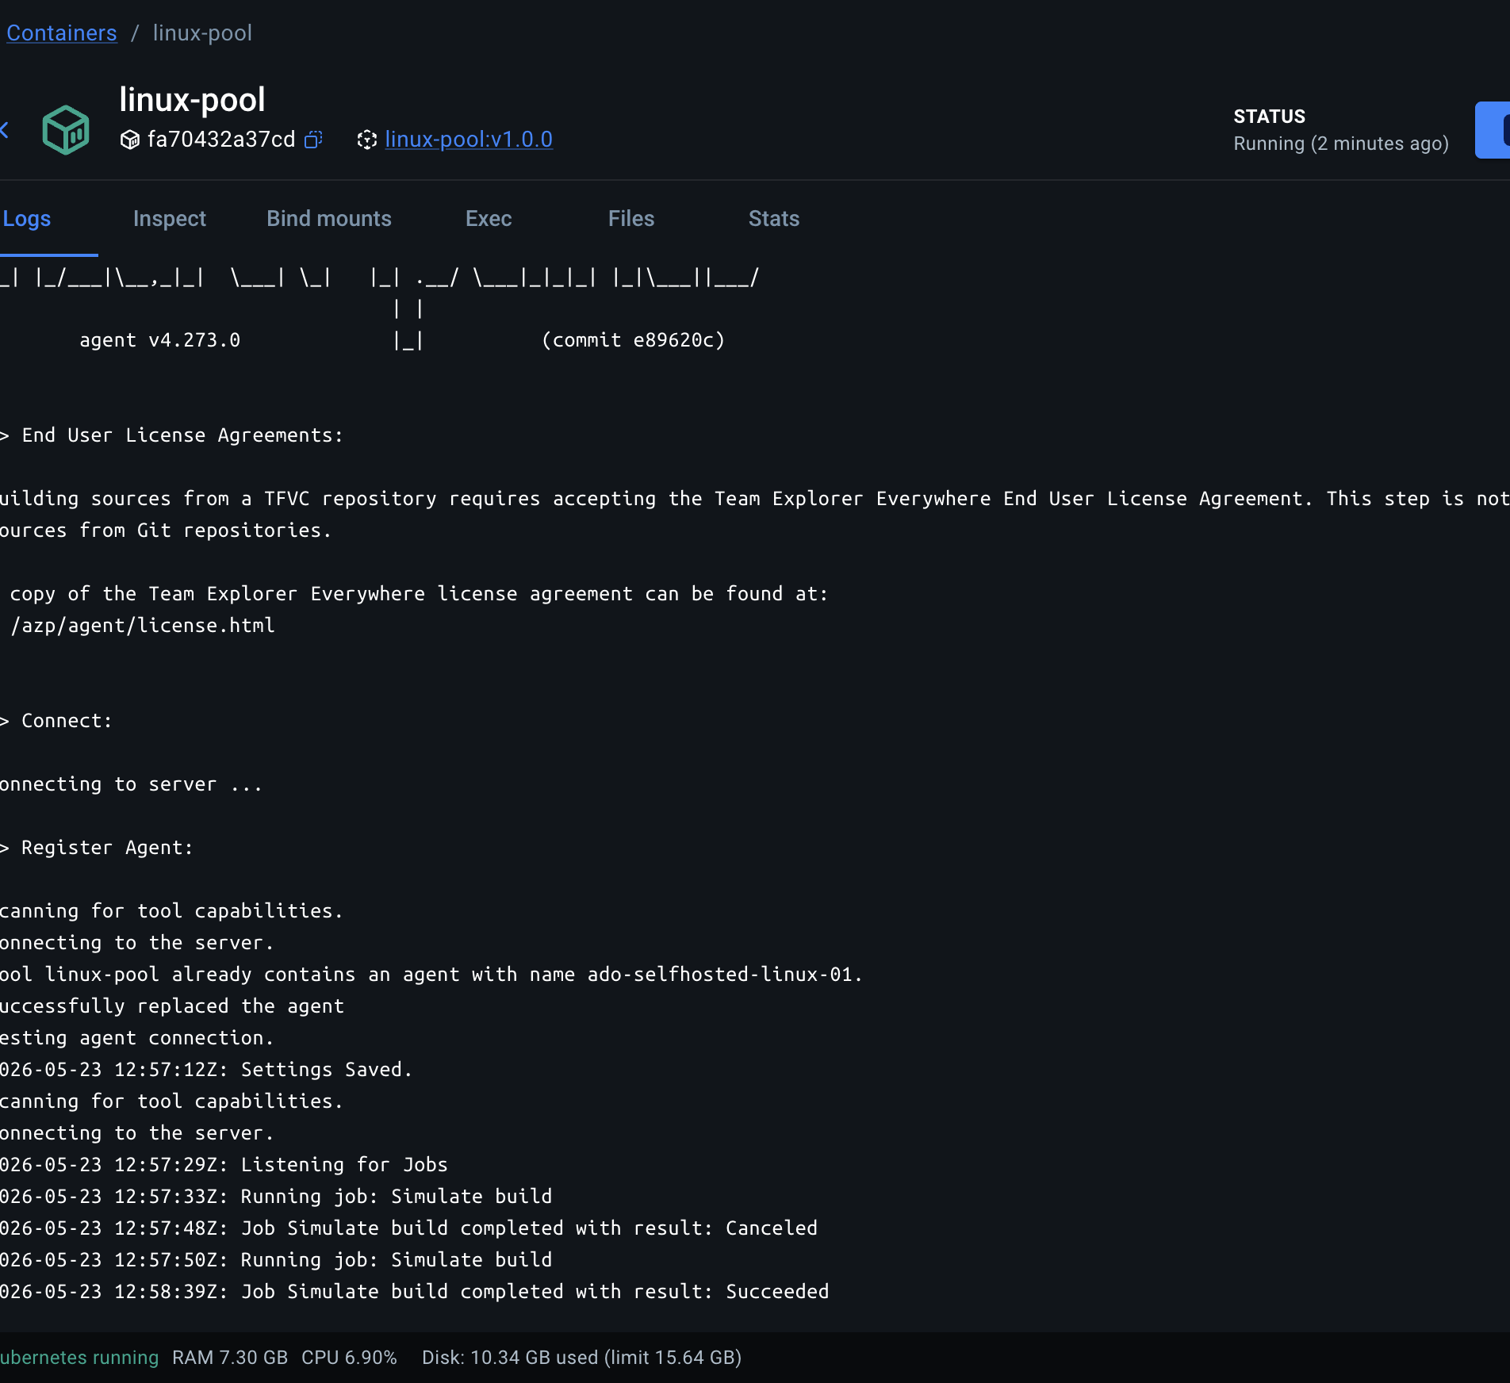
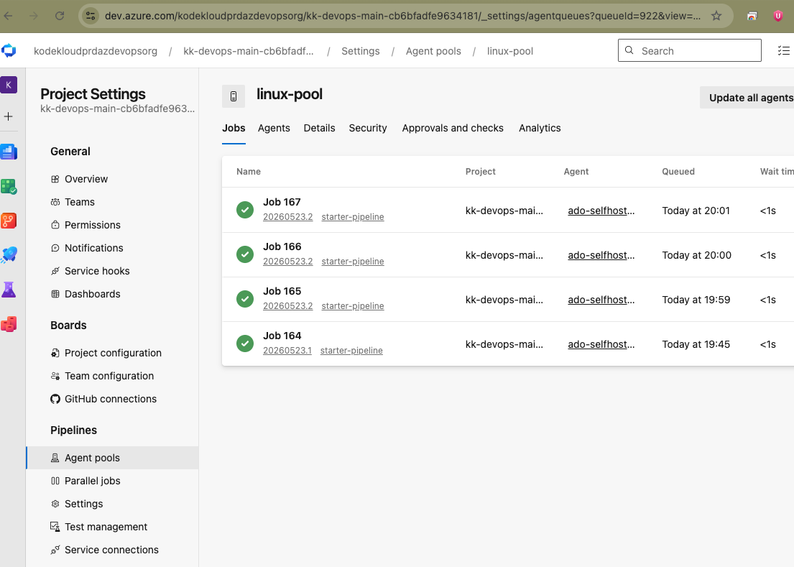
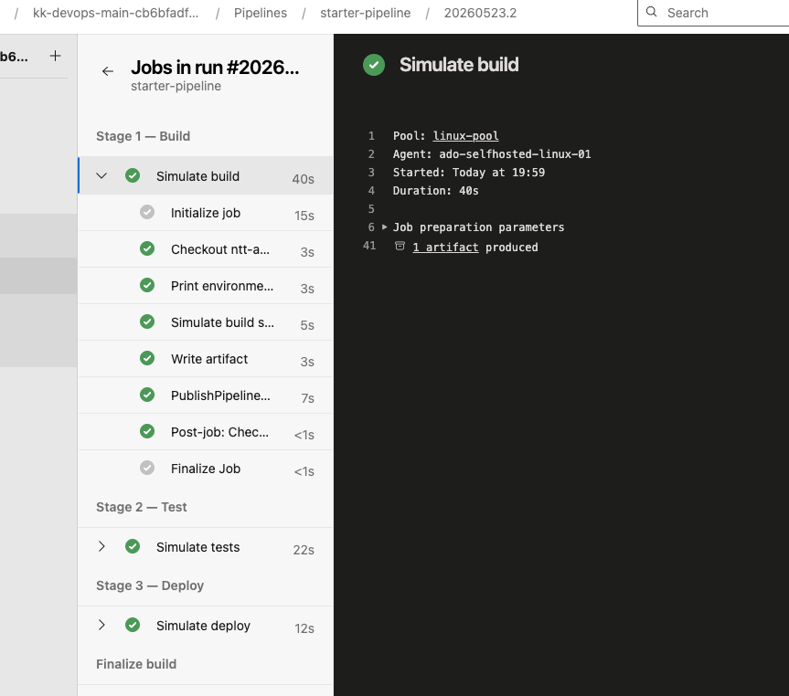
Self-hosted Agent Evidence
Agent image built from Dockerfile → run as a Docker container locally
Container self-registers to ADO pool ado-selfhosted-linux via start.sh
Pipeline stages execute on this containerized agent — no Microsoft-hosted runner used

Slide 14
ADO Pipeline & Reusable Templates
Build & Test → Security Scan → Push to ACR → Deploy Dev → Smoke Test → Manual Approval → Deploy Prod → Auto-Rollback
Template | What it does
build-container.yml | Maven build + test · multi-stage Docker build · exports image.tar.gz as pipeline artifact
security-scan.yml | Trivy CVE gate · blocks HIGH/CRITICAL · publishes JSON + SARIF report
push-acr.yml | Loads artifact · pushes :BuildId + :git-sha to ACR · no silent image rebuild
deploy-appservice.yml | Deployment job · triggers ADO environment approval gate · writes :stable tag after prod success
smoke-test.yml | Health check with 5 × 20s retry loop · /actuator/health must return 200 OK
post-deploy-validation.yml | Validates health status · homepage response time ≤ 5s · /owners endpoint reachable
rollback.yml | Resets App Service to :stable · restarts container · confirms health before exit

Slide 15
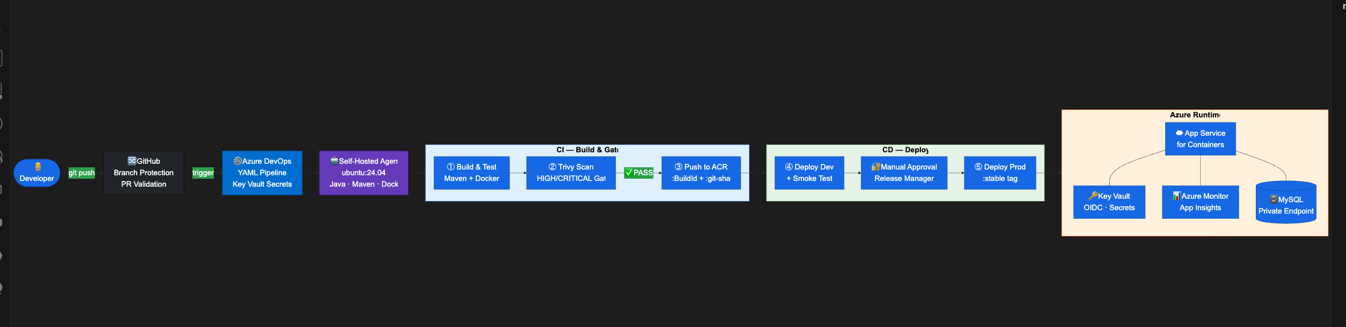
Target Pipeline- Architecture

Slide 16
GitHub Actions -Alternative
Platform | Choose When
Azure DevOps | Enterprise-wide ALM · Work item + PR traceability · ADO Environments approval gates · Key Vault-backed secrets · Large team governance
GitHub Actions | GitHub-native source control · Open source projects · PR-based validation workflows · Simpler pipeline with fewer governance layers
Builds the same Spring PetClinic container image using identical Maven + Docker steps
Scans with Trivy (aquasecurity/trivy-action) — same CVE gate as the ADO pipeline
Authenticates to Azure via OIDC (azure/login@v2) — no client secrets, no stored passwords
Deploys to Azure App Service for Containers using azure/webapps-deploy@v3
SARIF report uploaded to GitHub Security tab (github/codeql-action/upload-sarif@v3)
GitHub Actions issues a per-job OIDC token — exchanged with Azure AD at runtime. No password is ever stored.

Slide 17
Secrets & OIDC — Zero Stored Credentials
What We Replaced | What We Use Now
Jenkins with credentials plain-text | Key Vault-backed variable group
echo $PASS | docker login | Docker@2 OIDC service connection
GitLab $CI_REGISTRY_PASSWORD | ACR service connection via OIDC
${bamboo.buildNumber} plan variable | $(Build.BuildId) — ADO built-in
Three Layers of Protection
Secrets never in YAML or Git — Key Vault is the only source
All values masked in every pipeline log — no accidental exposure
OIDC replaces stored credentials — token lives only for the job duration

Slide 18
Immutable Image Promotion Chain
Pipeline Stage | What Happens | Tag Written
Build & Test | Maven build → Docker multi-stage → docker save artifact | None — local only
Security Scan | docker load same artifact → Trivy HIGH/CRITICAL gate | None — blocked if CVE found
Push to ACR | docker load → push to registry | :BuildId + :git-sha
Deploy Dev | Pull :BuildId → deploy → smoke test | None
Manual Approval | Release Manager approves in ADO | None
Deploy Prod | Pull same :BuildId → deploy prod | stable written on success
Auto-Rollback | Redeploy :stable — last known good | None

Slide 19
Release Governance & Approvals
Three layers of protection
Dev vs Prod Deploy Model
git push → Dev (auto-deploy) → ✅ Smoke Test → 🔐 Human Approval → Prod Deploy
Layer | What We Enforce
🔀 Branch Protection | PR required · 1 reviewer · build must pass · no force push
🔐 Approval Gate | Pipeline pauses before prod · Release Manager must approve in ADO
👥 Segregation of Duties | Dev builds · Manager approves · no one controls both

Slide 20
Observability
Layer | Tool | Captures
Platform | Azure Monitor + Log Analytics | CPU · Memory · 4xx/5xx rates
Application | Application Insights (Java agent) | Traces · Exceptions · Dependencies
Pipeline | deploy-logs-<env>.zip artifact | Per-deployment audit archive
Container | az webapp log tail | Spring Boot startup · Runtime errors

Slide 21
Health Validation & Rollback
Column1 | Column2 | Column3
Stage | Validation | Pass Criteria
Dev — Smoke Test | 5 retries × 20s | /actuator/health → HTTP 200
Prod — Post-Deploy | 3 checks in sequence | Health UP · RT < 5s · /owners → 200
Triggered automatically if DeployProd or PostDeploy Validation fails.
❌ Failure detected → Redeploy :stable → Restart App Service → Health check (30s) → ✅ Confirmed

Slide 22
Migration Factory & Top Risks
Wave 1 Onboarding (per app)
Step 1 — Run pipeline_inventory_analyzer.py → get risk score
Step 2 — Copy azure-pipelines.yml, update imageRepository, appName, dockerfilePath
Step 3 — Add app secrets to Key Vault variable group
Step 4 — Create ADO Environments — dev (auto) + prod (with approver)
Top Risks & Mitigations
🔴 Plain-text credentials in Jenkins — migrate all secrets to Key Vault-backed variable groups; audit Jenkins credential store before cutover
🟠 Mutable :latest tags — enforce :BuildId + :git-sha; block :latest tag in deployment pipeline
🟠 Self-hosted agent compromise — run as non-root azpuser; rotate PAT regularly; use immutable agent container image; route egress through Firewall

Slide 23
Appendix- Jira Cloud Migration
✅ Tempo Timesheets — cloud-compatible, no action needed
⚠️ Script Runner — review required, validate feature parity in Jira Cloud
❌ Custom Legacy Plugin — not supported, replace with Forge app or redesign
Assessment → test migration → UAT → production cutover → hypercare
Waves with change freeze and 72h rollback window
Pre-migration: deactivate inactive users, resolve script runner gaps, document custom workflows

